Slide 1



Raleigh INFANT and Admirals Academies
SEND Information Report
September 2026
Reporting on academic year 2025-2026

Slide 2
Publication Date: September 2026
Review Date: September 2027
At Raleigh Infant and Admirals Academies we believe in achievement for all. We want to create an inclusive culture in our school, and we aim to be responsive to the diversity of children’s backgrounds, interests, experience, knowledge and skills, so that all pupils, regardless of individual need, make the best possible progress.
This SEND Information Report describes the range of provision and support available for children as and when appropriate. This is subject to change depending on budgetary constraints and policy review.

Slide 3
Welcome to our SEND information report which is part of the Norfolk Local Offer for Learners with Special Educational Needs and Disabilities.
At Raleigh Infant and Admirals Academies, we embrace the fact that every child is different, and, therefore, the educational needs of every child is different; this is certainly the case for children with Special Educational Needs.
At Raleigh Infant and Admirals Academies we believe that:
All children should be valued regardless of their abilities and behaviours.
All children are entitled to a broad and balanced curriculum which is matched to meet their needs.
All teachers are teachers of children with special educational needs.
All children can learn and make progress.
Effective assessment and provision for children with SEND will be secured, in partnership with parents, children, the LA and other partners.

Slide 4
This report details our annual offer to learners with SEND.
To be effective it needs the views of all: parents/carers, pupils, governors and staff.
If you have any comments, please contact:
Mr G Sadler (Principal) or
Mrs V Hall (SENCo) Special Educational Needs Co-Ordinator
Ms S Pickrell – Family Support Worker
Mr D Knight - AC member for SEND
Contact details: Tel – 01842 753279 Email: office@adm.eastern-mat.co.uk
Approved by: Greg Sadler Date: September 2026
Last reviewed: September 2025 Next review due by: September 2027

Slide 5
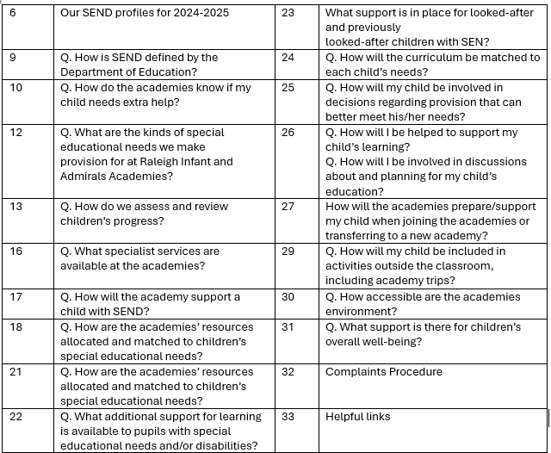
SEND Information Report Contents

Slide 6
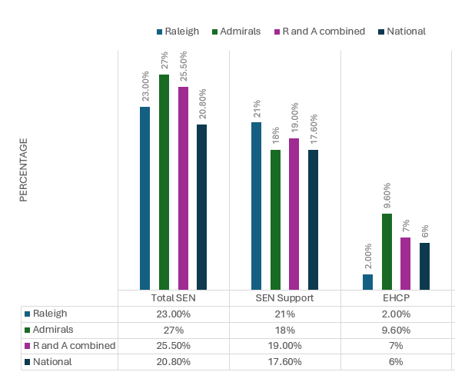
Our SEND profiles for 2025-2026
Our SEND profiles compared with National Data
(June 2026)

Slide 7
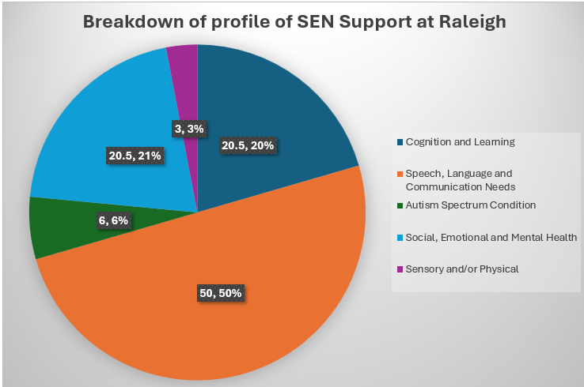
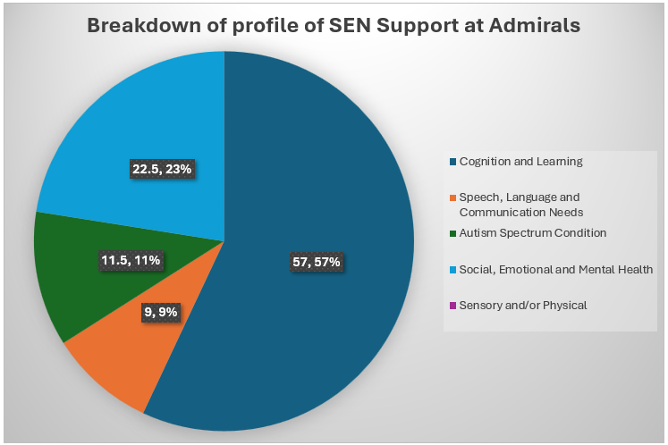
Our SEND profiles for 2025-2026
23% of children at Raleigh Infant Academy have a primary identified area of need; the breakdown is shown here.
27% of children at Admirals Academy have a primary identified area of need; the breakdown is shown here.

Slide 8
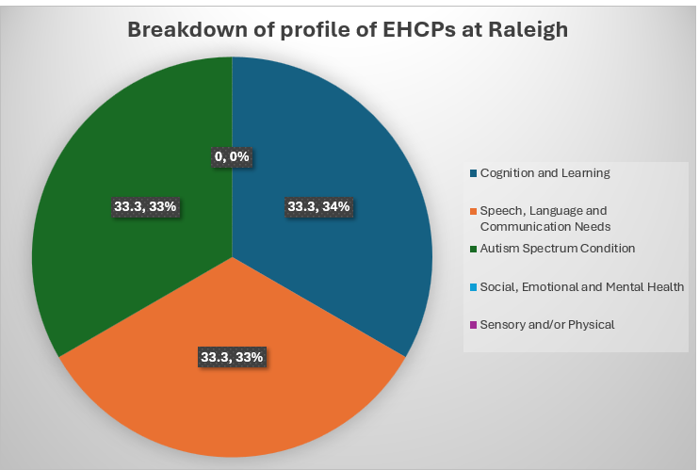
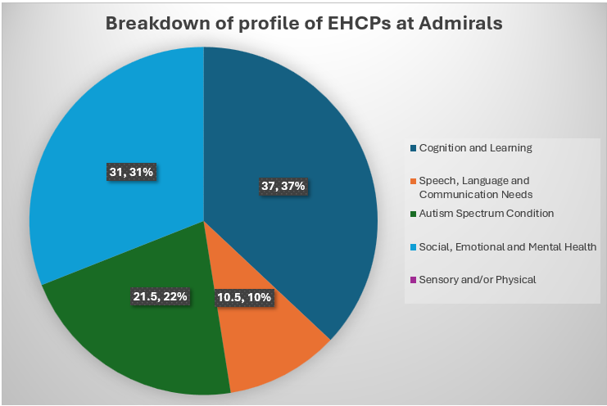
Our SEND profiles for 2025-2026
2% of children at Raleigh Infant Academy have an EHCP – the breakdown of their primary identified need is shown here.
9.6% of children at Admirals Academy have an EHCP – the breakdown of their primary identified need is shown here.

Slide 9
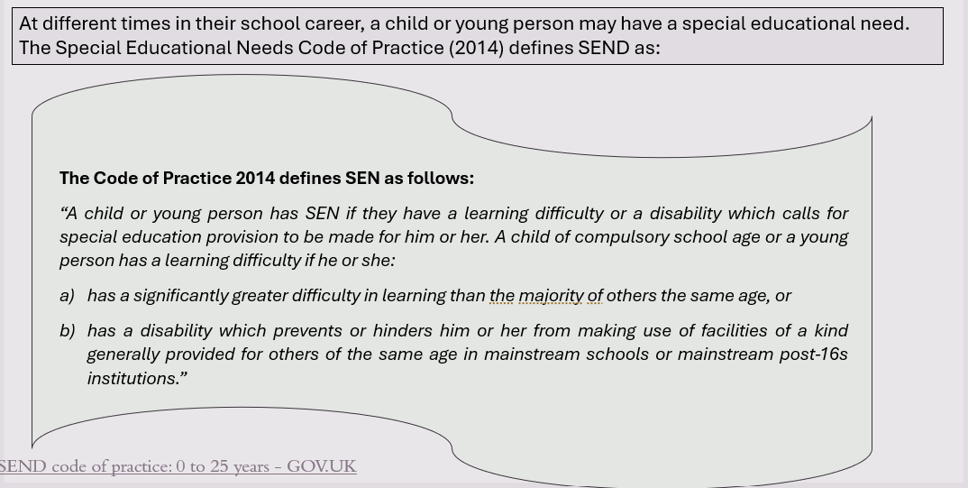
Q. How is SEND defined by the Department of Education?

Slide 10
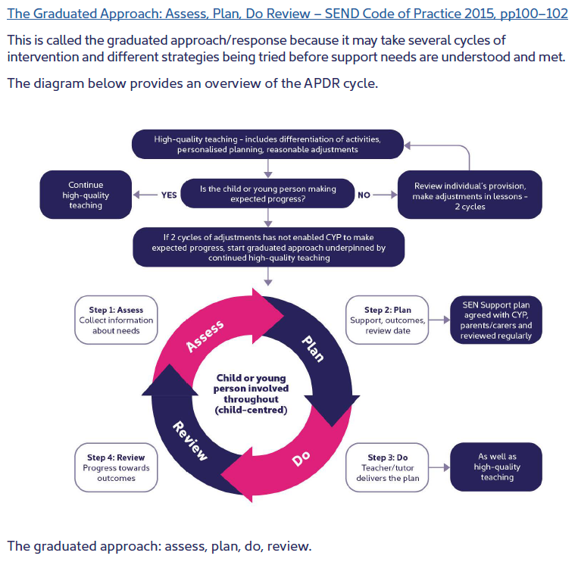
Q. How do the academies know if my child needs extra help?
Where a pupils’ progress is significantly slower than that of their peers, or fails to match their previous rate of progress, despite high quality teaching, targeted at specific areas of difficulty, it may be that the child has SEND. Information will be gathered, including seeking the views of parents and the pupil, as well as from teachers and assessments.
There can be many reasons for learners ‘falling behind.’ These may include absences, attending lots of different schools or worries that distract them from learning. Children who experience such barriers to learning are vulnerable, but this does not mean that all vulnerable learners have SEND. Only those with a learning difficulty that requires special educational provision ‘additional to’ or ‘different from’ the usual differentiated curriculum will be identified as having SEND.
Once a child is identified as having SEND, we follow the SEND Code of Practice Graduated Approach. This involves regular meetings with the child and parent to monitor, assess and review progress and outcomes.

Slide 11
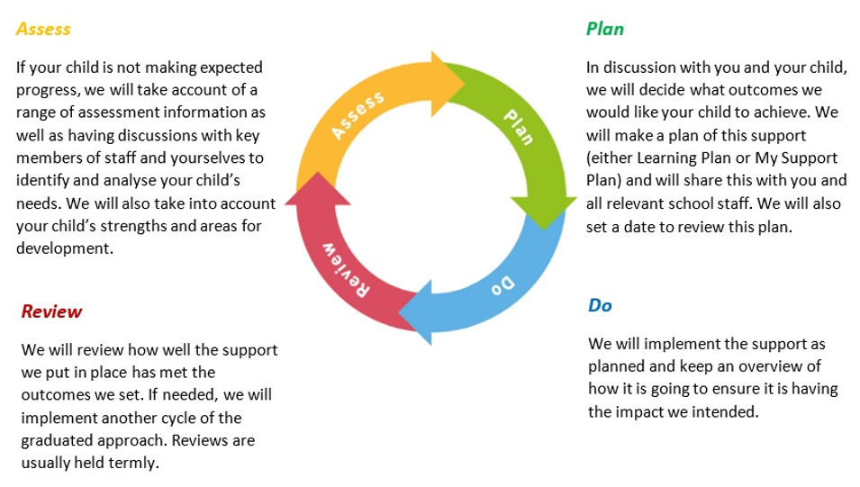
The Graduated Response: Assess, Plan, Do Review cycle
Monitoring progress is an integral part of teaching and leadership at Raleigh Infant and Admirals Academies. We follow the ‘assess, plan, do, review’ model and ensure that parents/carers and children are involved in the process.

Slide 12

Q. What are the kinds of special educational needs we make
provision for at Raleigh Infant and Admirals Academies?
Cognition and Learning
Children might:
• Learn at a slower pace
• Find the curriculum difficult
• Struggle with organisation and memory
• Have a specific difficulty in literacy or numeracy e.g. Dyslexia, Dyscalculia, Dyspraxia
Sensory and / or Physical
Children might have a:
• Vision impairment
• Hearing impairment
• Multi-sensory impairment
• Motor skill difficulties • Physical disability
Sensory Processing e.g. noise
Social, Emotional & Mental Health
Difficulties
Children might:
• Find relationships difficult, appear withdrawn or isolated
• Behave in ways that affect their learning
• Have underlying mental health difficulties such as anxiety, depression, self-harming, eating disorders
• Have disorders e.g. ADD, ADHD, Attachment Disorder
Communication and Interaction
Children might:
• Struggle to talk or say what they want to
• Find it hard to understand what others are saying
• Find conversations and play confusing and challenging
• Have a diagnosis of Autism
Some pupils may have needs that covers more than one of these areas

Slide 13

Q. How do we assess and review children’s progress?
Children, parents/carers, teaching and support staff are directly involved in the review progress. This review takes the form of a formal meeting, where the IEP targets can be reviewed and progress and next steps can be discussed. If a learner has an Education Health and Care Plan (EHCP), the same termly review conversations take place, as well as an annual formal review of the EHCP.
The Academy senior leaders track the attainment and progress of all children in Reception to Year 6, including those with special educational needs, through a termly pupil data drop. Areas for concern are identified and fed back to class teachers for action. The results are also analysed by the class teacher and used to inform the ‘assess, plan, do, review’ cycle.
The SENCo collates the impact data from targeted interventions. Adaptations to interventions and additional support are made following the review of this data.
Data from assessments is compared against historic school data, in addition to comparisons with National statistics

Slide 14
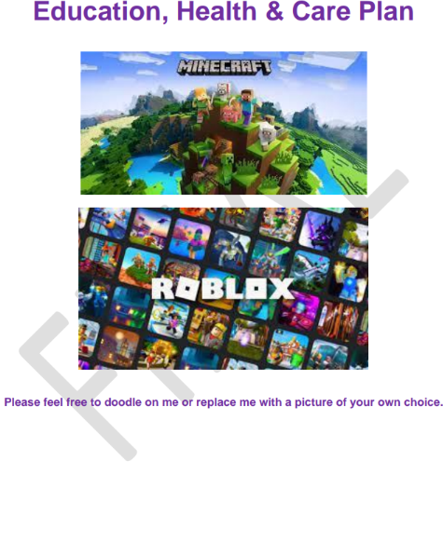
Education Health Care Plans
For a very small percentage of pupils. whose needs are significant and complex, a request will be made to the local authority to conduct an assessment of their education, health and care needs. This may result in an Education, Health and Care (EHC) plan being provided. Where a child has an EHCP, there will be an annual review held in addition to the termly review meetings, taking into account the views of the child, their parent or carer, and all other professionals involved with the child. These pupils will receive additional provision to support their needs. The school will outline additional support and provision on a costed provision map which is submitted to the Local Authority as part of the process for allocating funding to support pupils with SEND in the academies. Further information about Norfolk EHCPs can be found here:
Education, health and care (EHC) plans - Norfolk County Council
School budget share - Norfolk Schools and Learning Providers - Norfolk County Council

Slide 15

The following assessments are used across our school to identify SEND needs
Communication and Interaction:
WELLCOMM – primary toolkit for speech and language
Renfrew Word Finding Test – vocabulary skills
Blank Levels – understanding of language
Checklists
Social Emotional and Mental Health
Boxall Profile
Strengths and Difficulties Questionnaire
Self-Esteem Indicator
SNAP IV – Attention and concentration
Checklists
Cognition and Learning:
Little Wandle – phonics
Salford – Sentence reading
Dyslexia Portfolio – literacy screening
YARC – reading and comprehension
HAST-2 – spelling
Sandwell Early Numeracy Assessment – EYFS/KS1 and KS2
Physical and Sensory
Fine motor skills checklists
Gross motor skills checklists
Sensory Profile checklist

Slide 16
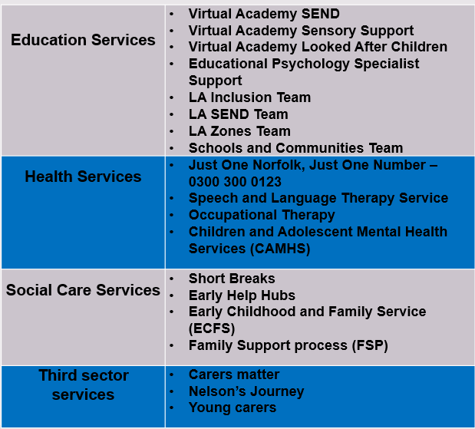




Q. What specialist services are available
at the academies?

Slide 17

Q. How will the academy support a child with SEND?
All pupils will be provided with high quality teaching that is adapted to meet the needs of all learners. The quality of classroom teaching provided for pupils with SEND is monitored through processes that include:
Classroom observation by the Senior Leadership Team/Trust Leaders/Academy SENCo
Ongoing assessment of progress made by pupils with SEND
Work sampling and scrutiny of planning to ensure effective matching of work to pupil need
Teacher meetings with the SENCo to provide advice and guidance on meeting the needs of pupils with SEND
Pupil and parent feedback on the quality and effectiveness of interventions provided
Attendance and behaviour records.
Pupils with a disability will be provided with reasonable adjustments to overcome any disadvantage experienced in the academy and increase their access to the taught curriculum.
All pupils with SEND have individual targets relating to their areas of need. Parents/carers are informed of these via the ILP review process and at Parent/carer consultation sessions.

Slide 18
Q. How are the academies’ resources allocated and matched to children’s special educational needs?
The academy receives funding to support pupils with SEND from a number of sources:
A proportion of the funds allocated per pupil to the academy to provide for their education called the Age Weighted Pupil Unit.
The Notional SEN budgets. This is a fund devolved to schools to support them to meet the needs of pupils with SEND.
For those pupils with the most complex needs, the academies may be allocated additional educational needs funding from the Local Authority’s High Needs SEN Funding allocation.
AUG 2526 Modelm SEND Allocation for Raleigh Academy
AUG 2526 Modelm SEND Allocation for Admirals academy

Slide 19
Interventions and resources used to support the four areas of need
Cognition and Learning | Communication and Interaction
Precision Teaching Literacy Gold Numicon Catch Up – Literacy and Numeracy Booster groups Visual stress assessments/coloured overlays Strategies/programmes for difficulties with: Auditory processing Working memory Short and long-term memory | Speech and Language therapy sessions Blank Levels of Language/Understanding Talk Boost LEGO Therapy Stammer/mutism strategies Colourful Semantics Programmes and strategies to support pupils with Autism e.g. Visual schedules Workstations Social Stories
Social, Emotional and Mental Health | Sensory and Physical
Emotional and well-being support - ELSA Drawing and Talking/Time to Talk Individual behaviour support/modification and monitoring plans Individual Risk Assessments 1:1 Specialist Counselling Forest Academy Nurture Groups Boxall Profile | Sensory Circuits Movement Breaks Physical aids – weighted blankets, writing slopes, posture packs, learning aids e.g. marble mesh bags Fine and gross motor skills interventions Safe Ports for sensory regulation

Slide 20
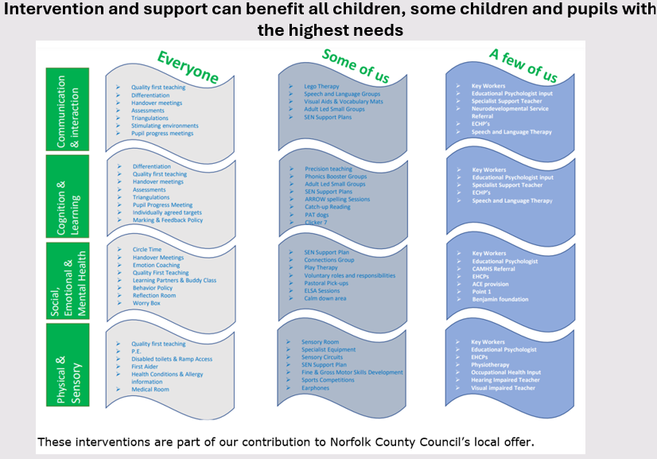

Slide 21

Q. How are staff at Raleigh Infant and Admirals Academies supported to work with children
with SEND and what training do they have?
The SENCo:
Ensures that all members of staff in academy have a clear understanding of each child's Special Educational Need and / or Disability and aids them in their practice.
Provides all staff with training on the SEND needs in the academy and training relating to specific children.
Updates the teaching staff in staff meetings about recent government initiatives within the SEND system and relays back information gathered from SEN conferences and courses.
Training to support Communication and Interaction needs | Training to support Cognition and Learning needs | Training to support Socal, Emotional and Mental Health needs | Training to support Physical and or Sensory needs
Speech and Language training Attention Autism (Bucket Time) LEGO Therapy training ELKLAN training | Little Wandle phonics training Adaptive Teaching | Drawing and Talking Therapy Mental Health Champions Norfolk Steps – Step Up and Step On | Paediatric First Aid Diabetes training EpiPen training Moving and handling training Sensory Circuits training

Slide 22

Q. What additional support for learning is available to pupils with special educational needs and/or disabilities?
Pupils with English as an additional Language (EAL) and SEN
All children with English as an Additional Language in the academies are supported through visuals, peer buddies and signing, to access learning. We carry out specific language interventions as appropriate. All areas of development are carefully considered and discussions with parents, through an interpreter or translation service, may take place to establish if the delay in learning is attributed to their command of English or to an emerging SEND need.

Slide 23

What support is in place for looked-after and previously
looked-after children with SEN?
Our Designated Teacher, Mrs Ewans will work with Mrs Hall, our SENCO, to make sure that all teachers understand how a looked-after or previously looked-after pupil’s circumstances and their SEN might interact, and what the implications are for teaching and learning.
Children who are looked-after or previously looked-after will be supported in the same way as any other child who has SEN. However, looked-after pupils will also have a personal education plan (PEP). We will make sure that the PEP and any SEN support plans or EHC plans are consistent and complement one another.
Please see our Looked after Children (LAC/PLAC) Policy for more information

Slide 24
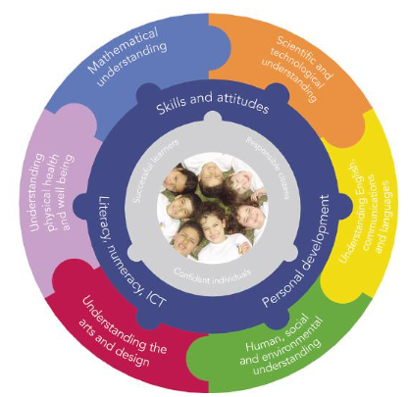
Q. How will the curriculum be matched to each child’s needs?
Teachers plan using pupil achievement levels, adapting tasks to ensure progress for every pupil in the classroom.
Where appropriate, the learning environment will be further adapted by the class teacher to reduce barriers to learning and enable the child to access the curriculum more easily.
These adaptations may include strategies suggested by the Special Educational Needs Coordinator (SENCo) and/or external specialists.
In addition, pupils may be provided with specialised equipment or resources such as ICT (e.g. SEND specific software, laptops) and/or additional adult help. All actions taken by the class teacher will be recorded and shared with parents.
The physical environment has been adapted to support children with medical needs (see Accessibility Plan)

Slide 25


Shemara and Turbinia: Enhanced SEN Provision
For a very small number of pupils, accessing a mainstream classroom may be too overwhelming for them on a full-time basis. These pupils will have an EHCP or an application in progress. Shemara and Turbinia have been developed to support these pupils. The pupils follow a bespoke curriculum adapted to their developmental needs whilst still following the national curriculum. 1:1 interventions are in place to support the section F outcomes identified in each pupils’ EHCP.
There are a maximum of 8 pupils in a group at any one time, supported by 2 adults. The pupils have opportunities for working with their year group peers as appropriate e.g. PE, Art, Science. Our ESP bases are managed by Mrs Hall, our SENCo.

Slide 26

Q. How will my child be involved in decisions regarding provision that
can better meet his/her needs?
SEN Support Plans (SSPs)
The academy listens to pupils when creating their SSPs. Pupil views are collected with support from a familiar member of staff. These are reviewed with the child each term
The views of pupils with an EHCP are sought prior to their annual review. Where appropriate, pupils are invited to attend the meeting.
Academy Council
Weekly house meetings take place. Each week the groups discuss a key question. The house leaders lead these meetings with the support of their pupil council team. The views of the group are then fed back to the SLT who will take the pupil views into account when making their decisions
Pupil Voice
The academy completes pupil voice questionnaires throughout the year. Talk time sessions take place in each class, discussions can be general or focus on something specific.

Slide 27

Q. How will I be helped to support my child’s learning?
Q. How will I be involved in discussions about and planning for my child’s education?
At Raleigh Infant and Admirals Academies:
You will be invited to come and talk openly with the class teacher and/or SENCo to establish where the need lies and the support you may need.
You will work in partnership with staff to support targets, and to keep the academies informed of developments and advice that you get from other services.
Either your child’s class teachers or SENCo will meet formally with you at least twice each year and an annual report is prepared and shared with you in the Summer Term.
You will be invited to class events and to share learning experiences with your child throughout the year.
Where your child holds an EHCP a formal review will take place annually from the date of the previous review, or sooner if needed. You are asked for your views as is your child throughout this process.
The academy operates an open-door policy.
If you have any concerns regarding your child’s progress or well-being, then please speak to your child’s class teacher or Mrs Victoria Hall (SENCo) to discuss your concerns.

Slide 28

Q. How will the academies prepare/support my child when joining the
academies or transferring to a new academy?
A planned introduction programme, is delivered in the Summer term to support transfer for pupils starting at Raleigh Infant and Admirals Academies in September. Parent/carers and children are invited to visit the academies and are given information to support them in helping their child to settle into the academy routine.
The SENCo meets with all new parents of pupils who are known to have SEND
If pupils are transferring from another setting, the previous academy records will be requested immediately and a meeting set up with parents to identify and reduce any concerns.
Foundation Stage staff will meet with parents prior to pupils attending the academy to make sure everything is in place ready for the child. Where necessary the SENCO will arrange a further meeting with parents and other professionals who are supporting the child
Class teachers of children joining from other academies will receive information from the previous academy
Pupils will also be given a transition booklet which they can refer to over the summer holiday.

Slide 29

Preparing for next steps
Transition is a part of life for all learners, whether that involves moving to a new class or moving to a new academy. We recognise that transition is an important time for all children, but especially so for a child with SEN. We work closely with parents, pupils and staff to ensure these transitions run as smoothly as possible.
We provide:
Opportunities for pupils and parents to meet staff in the new academy.
Accompanied visits to other providers, as appropriate.
Transition booklets for pupils prior to starting their new academy.
For pupils transferring to local academies, the SENCos of both academies will meet to discuss the needs of pupils with SEN in order to ensure a smooth transition.
The records of pupils who leave the academy mid-phase will be transferred within five working days of the new school notifying us that a child has been enrolled at their school.

Slide 30


Q. How will my child be included in activities outside the classroom including academy trips?
Class Trips and clubs
At Raleigh Infant and Admirals Academies, we believe all learners are entitled to access to extra-curricular activities. We are committed to make reasonable adjustments to ensure participation for all. Risk assessments are carried out and procedures are put in place to enable all children to take part in all academy activities. Any additional support or necessary adjustments are recorded on the risk assessment for that activity. The academy ensures it has sufficient staff expertise to ensure that no child with SEND is excluded from any academy provided activity.

Slide 31

Q. How accessible are the academies environment?
The academies are fully compliant with DDA (Disability Discrimination Act) requirements.
The academies have an up-to-date accessibility plan which is reviewed each year and whenever there is building work. Our Accessibility Plan describes the actions the academies have taken to increase access to the environment, the curriculum and to printed information, and is available on the website (Policies and Documents)
In addition:
We have Key Stage 1 and a Key Stage 2 small specialist provision classes which have been developed to improve inclusion for vulnerable pupils.
We have reorganised class bases to accommodate the specific needs of pupils.
Ramps have been put in place leading to classrooms and to the academy entrance.
We ensure, wherever possible, that the equipment used is accessible to all children regardless of their needs.
After-school provision is accessible to all children, including those with SEN.
For pupils with English as an additional language, we access support from the Local Authority EAL Team
Extra-curricular activities are accessible for children with SEN.
The children can access Nurture Provision in our dedicated Nurture Group space
We have an outside learning area (Forest Schools)

Slide 32

Q. What support is there for children’s overall well-being?
The well-being of pupils at Raleigh Infant and Admirals Academies is a priority.
The FSW (Family Support Worker) organises pastoral care. Staff support pupils to ensure that those who require pastoral support can access support at the time it is needed. A variety of pastoral interventions are available.
The academies have 1 trained mental health first aider.
The academies have 2 trained ELSAs (Emotional Literacy Support Assistants)
The FSW leads a team of Pastoral Support Assistants who carry out morning check-ins and Wishes and Feelings work with vulnerable children
The academies have access to expert support; we employ a counsellor who works with identified pupils.
Where there is a medical need, staff work closely with health professionals to ensure these needs are met.
For some children with a medical need, a Care Plan will be created so that there is a clear protocol that provides accurate information regarding the correct medical care for the child.
Prescribed medication can be administered if the academy is in receipt of a signed medication administration permission form from parents.

Slide 33
Complaints Procedure
If you are not happy with the provision made available to your child, you can:
Talk to your child’s class teacher
Discuss your concerns with the Special Educational Needs Co-ordinator
Get free confidential and impartial information, advice and support from:
Norfolk SENDIASS (Special Educational Needs and Disabilities Support Service) This service provides free, confidential and impartial information, advice and support about SEND for children, young people, parents and carers.
T 01603 704040
W: https://www.norfolksendiass.org.uk/
KIDS dispute resolution service
T: 03330 062835
E: senmediation@kids.org.uk
W: www.kids.org.uk
The Eastern Multi Academy Trust’s Complaint Policy can be found on our website.

Slide 34

Our policies are available on our Website:
SEND Policy
Equality Information
Complaints Procedure
Medical Needs
Behaviour Policy
Safeguarding Policy
Accessibility Plan

Slide 35

Useful Links
Norfolk Local Offer for SEND – www.norfolk.gov.uk/send
Here you will find information about provision that is available, and expected provision, across: Education, Health and Social care for children and young people who have special educational needs and disabilities (SEND).
Norfolk SEND Partnership: www.norfolkparentpartnership.org.uk
National SEND Code of Practice: www.gov.uk/government/publications/send-code-of-practice-0-to-25
You will find more links on our website

